Slide 1

Journal Club 6: Modeling Count
Dominic Adducci
March 13, 2024
Notes:
TIP: ”Save as” this template before you begin and rename it to the title of your presentation. That way you will retain a copy of this blank template for future use.

Slide 2
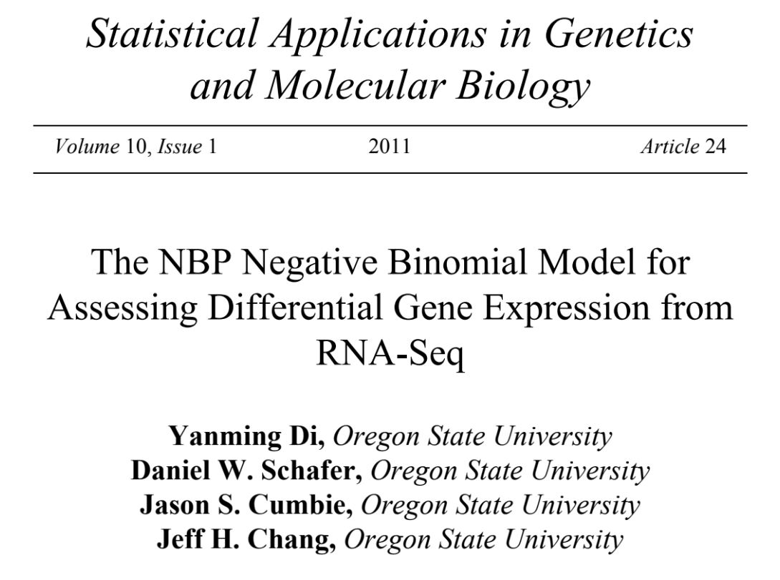
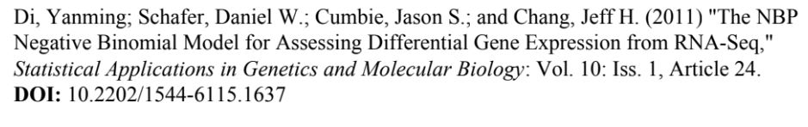

Slide 3

Outline
Introduction
RNA-Seq Data Structure and Possible Tests for Differential Gene Expression
The NBP Distribution
Adaptation of the Robinson and Smyth Exact Test
Library Size Adjustments
Arabidopsis Example
Simulations
Conclusions

Slide 4
Introduction: RNA-Seq Crash Course
High throughput RNA sequencing (RNA-Seq) measures gene expression
Isolate and randomly fragment mRNA
Covert mRNA to complementary DNA (cDNA)
Prepare cDNA for sequencing
cDNA sequencing produces hundreds of millions of short RNA-Seq reads
These RNA-Seq reads are aligned to a reference database
The relative frequency of RNA-Seq reads that match a gene measure a gene’s expression

Slide 5
Introduction – The Problem
Identification of differentially expressed genes between two groups using counts…Simple???
3 key problems:
A very large number of genes to be tested
Small number of biological samples
Count variability that does not follow binomial or Poisson distributions
Small number of biological samples precludes asymptotic based methods

Slide 6
Introduction – The Solution
Robinson and Smyth proposed negative binomial distribution
Offers a more realistic model for RNA-Seq count variability that the Poisson distribution
Permits an exact (non-asymptotic) test for comparing two groups
Saving of statistical power from estimating negative binomial dispersion parameter from all genes combined*
* Constant dispersion parameter not realized for RNA-Seq data sets examined
Several approaches between single dispersion parameter and separate dispersion parameters

Slide 7
Introduction – Modeling Approaches
Comparison between several approaches
Dispersion modeling approaches
edgeR multiple options (trend, moderated common) – uses empirical Bayes to shrink genewise dispersion estimates towards a constant value
DESeq – dispersion parameter modeled as a smooth function of the mean, used nonparametric regression to fit NB variance as function of the mean
NBP – non-constant dispersion parameter directly within a parametric family
Naive approaches
Poisson
Two-sample t-test
Negative binomial with constant dispersion parameter
Authors approach was NBP – relative transparency, model simplicity, absence of user-specified tuning parameters for statistical fitting

Slide 8
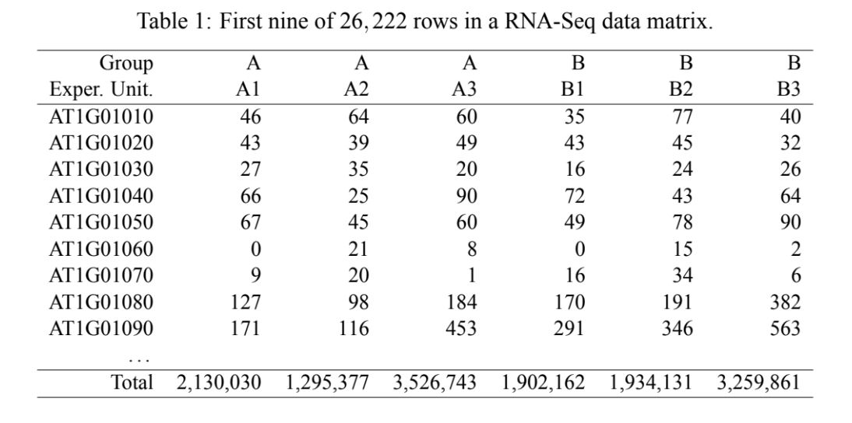
RNA-Seq Data and Tests
Table – Example of RNA Seq data
Columns are response vectors for individual response units (biological samples) – 6 total
Cell values are frequency of RNA-Seq reads that match genes for each row
Last row number of mappable RNA-seq reads for each sample – active library sizes
Two groups in this example – Arabidopsis thaliana

Slide 9
RNA-Seq Relative Frequency
Authors note that gene expression in this paper is indicated by relative frequency.
Potential problem in analysis:
Only one gene is truly differentially expressed
Higher relative frequency of reads for one gene must be accompanied by lower relative frequency of other genes
This is because relative frequencies must sum to 1, even if other genes not truly differentially expressed
Authors state that this is a negligible issue, as relative frequencies are generally spread across many genes
Normalization not used in this example, but could still be applicable

Slide 10
RNA-Seq Model Start
Random vector of RNA-Seq reads for observational unit
Observational unit – biological sample
Condition on the total number of RNA-Seq reads for unit
Multinomial model for entire column
Binomial model for individual cell in a column
Poisson approximation to the binomial distribution

Slide 11
RNA-Seq Expected Count
$$E\left(Y_{ijk} | m_{jk}\right)=μ_{ik}=m_{jk}π_{ik}$$
Y_{ijk} = random variable for number of RNA-Seq reads for gene i from observational unit j, in treatment group k
m_{jk} = total number of RNA-Seq reads for observational unit j within group k (active library size)
µ_{ik} = expected number of genes i in group k
Π_{ik} = proportion of genes i in group k (relative frequency)

Slide 12
RNA-Seq Poisson and NB
Differential expression is established if π_{i1} is significantly different from π_{i2} for gene i
Poisson variance significantly greater than mean – overdispersion
Negative Binomial (NB) distribution can be thought of as a gamma mixture of Poisson distributions

Slide 13
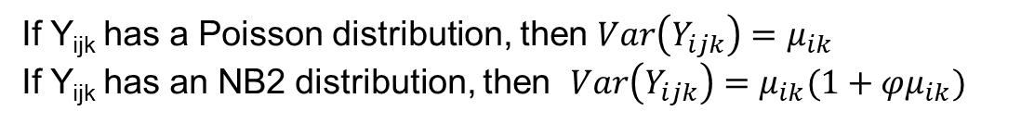
RNA-Seq Robinson and Smyth – NB2 Distribution
If Y_{ijk} has a Poisson distribution, then $Var\left(Y_{ijk}\right)=μ_{ik}$
If Y_{ijk} has an NB2 distribution, then $Var\left(Y_{ijk}\right)=μ_{ik}(1+φμ_{ik})$
The φ parameter models biological variability
Test based on known φ far more powerful than test based on estimated φ, due to small sample size
Assuming a constant φ across genes equivalent to a known φ
This assumption does NOT hold for many data sets

Slide 14
RNA-Seq NBP Distribution
If Y_{ijk} has an NBP distribution, then $Var\left(Y_{ijk}\right)=μ_{ik}(1+φμ_{ik}^{α−1})$
Solution proposed by authors is the NBP distribution
NB2 is a specific version of NBP where α = 2
Two parameters of φ and α are estimated from all genes combined, and subsequently treated as known, saving statistical power

Slide 15
RNA-Seq DESeq Method
Anders and Huber approach (DESeq): $Var\left(Y_{ijk}\right)=μ_{ik}(1+φ_{μ}μ_{ik})$
DESeq method generalizes the Robinson and Smyth approach by incorporating relationship between φ and μ
A nonparametric regression estimates dependence of φ on μ
“trend” option in edgeR incorporates nonparametric regression modeling of φ_{μ} within an empirical Bayes estimation scheme.

Slide 16
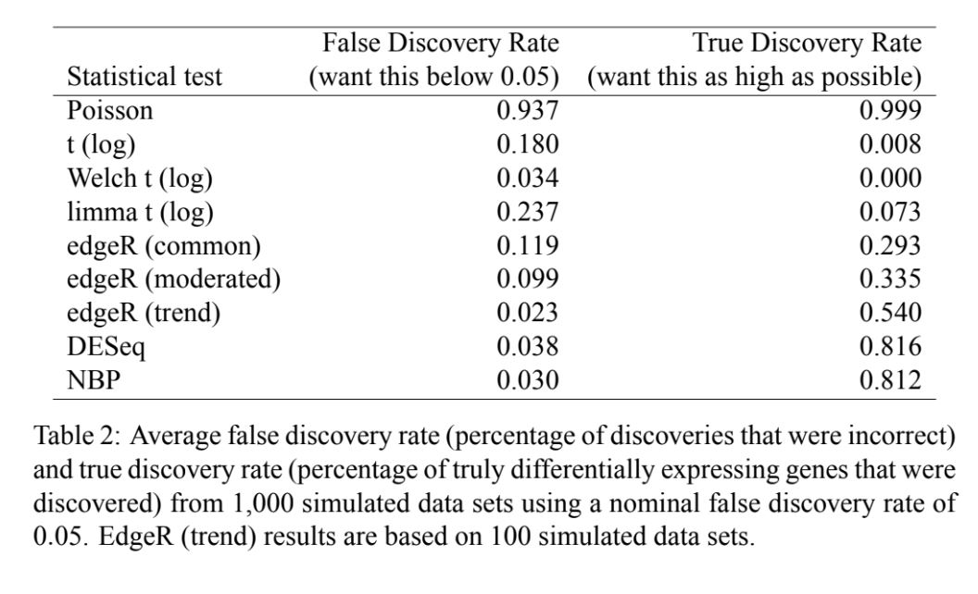
RNA-Seq Table 2

Slide 17
NBP Distribution
Previous work established the NBP distribution [Greene (2008) and Hilbe (2008)], but application was not assessed
Consider NBP model as a gamma mixture of Poisson distributions
Y|Z ~ Poisson with mean Z
Z ~ gamma with mean μ
NB variance depends on parameterization of two-parameter gamma family
Z ~ gamma with mean μ and variance φμ. Marginal Y is NB with mean μ and variance μ(1 + φ). NB1, linear function of mean.
Z ~ gamma with mean μ and variance φμ². Marginal Y is NB with mean μ and variance μ(1+μφ) NB2, quadratic function of mean.

Slide 18
NBP Distribution
General form, called NBP, where variance of gamma distribution is an arbitrary power of the mean, φμ^{α}
Α is an unknown parameter
NPD parameterization of NB distribution with variance μ(1+φμ^{α-1})
NB1, NB2, and NBP describe same probability distributions. NBP general form with flexible mean-variance relationship

Slide 19
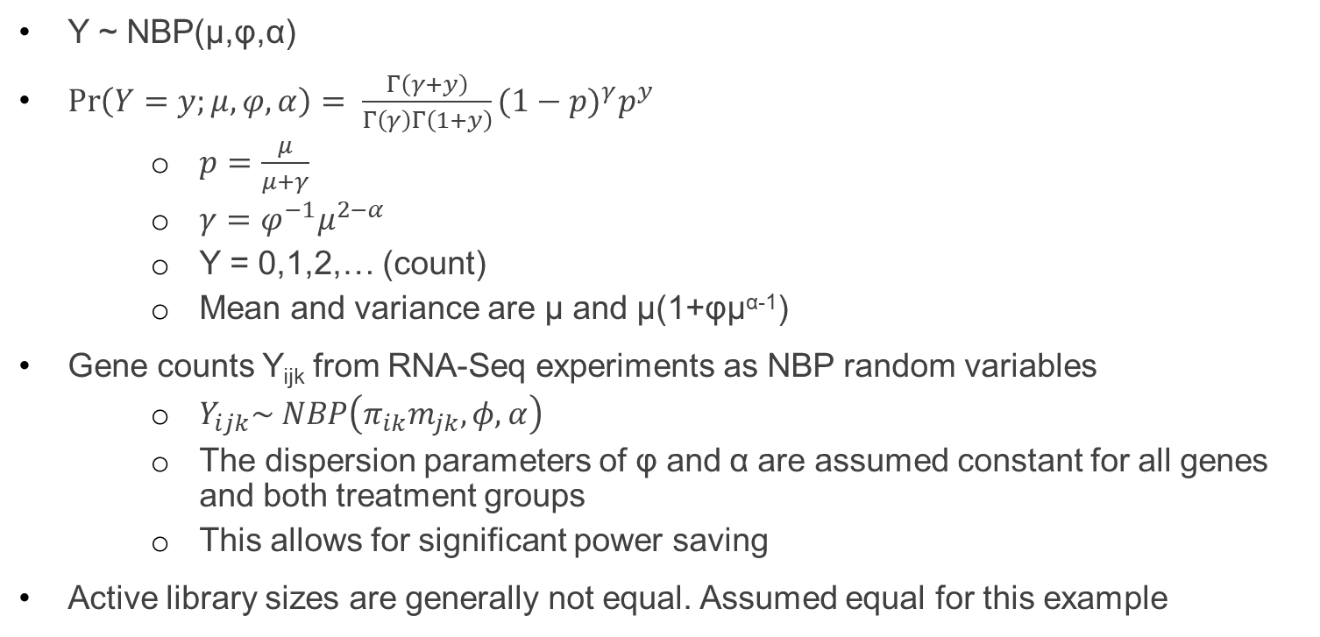
NBP Distribution- PMF
Y ~ NBP(μ,φ,α)
$\operatorname{Pr}\left(Y=y;μ,φ,α\right)= \frac{Γ\left(γ+y\right)}{Γ\left(γ\right)Γ\left(1+y\right)}{(1−p)}^{γ}p^{y}$
$p=\frac{μ}{μ+γ}$
$γ=φ^{−1}μ^{2−α}$
Y = 0,1,2,… (count)
Mean and variance are μ and μ(1+φμ^{α-1})
Gene counts Y_{ijk} from RNA-Seq experiments as NBP random variables
$Y_{ijk}\sim NBP\left(π_{ik}m_{jk},φ,α\right)$
The dispersion parameters of φ and α are assumed constant for all genes and both treatment groups
This allows for significant power saving
Active library sizes are generally not equal. Assumed equal for this example

Slide 20
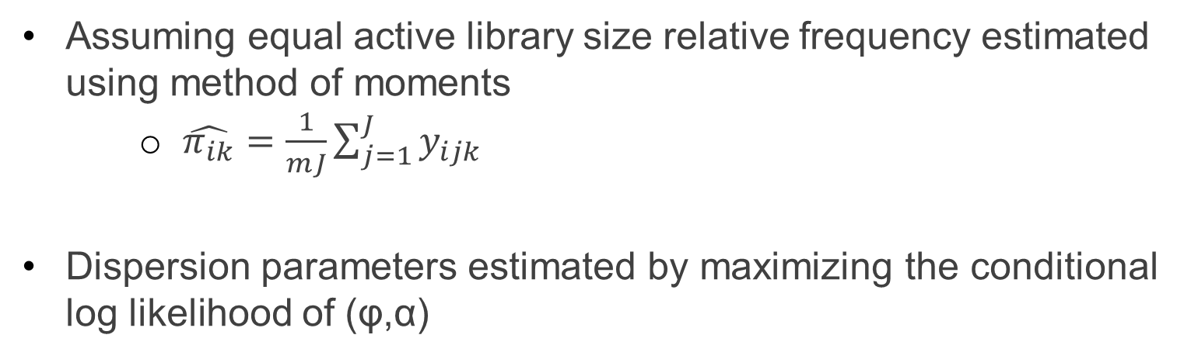
NBP Distribution - Estimates
Assuming equal active library size relative frequency estimated using method of moments
$\hat{π_{ik}}=\frac{1}{mJ}\sum_{j=1}^{J}{y_{ijk}}$
Dispersion parameters estimated by maximizing the conditional log likelihood of (φ,α)

Slide 21
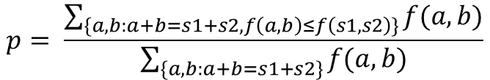
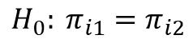
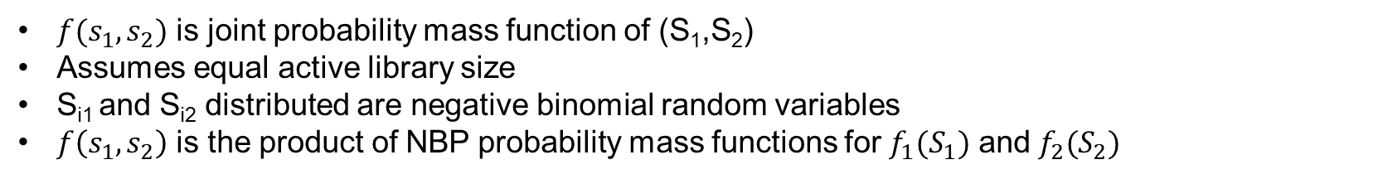
Adaption of the Robison and Smyth and Exact Test
$$H_{0}: π_{i1}=π_{i2}$$
Null hypothesis states the relative frequency for a gene, i, is the same between both groups
Statistical evidence comes from the sequence read counts Y_{ijk} between the two groups
Exact test is based on the conditional distribution S_{i1}|S_{i1}+S_{i2}
$$p= \frac{\sum_{\{a,b:a+b=s1+s2,f\left(a,b\right)≤f\left(s1,s2\right)\}}{f(a,b)}}{\sum_{\{a,b:a+b=s1+s2\}}{f(a,b)}}$$
$f(s_{1},s_{2})$ is joint probability mass function of (S₁,S₂)
Assumes equal active library size
S_{i1} and S_{i2} distributed are negative binomial random variables
$f\left(s_{1},s_{2}\right)$ is the product of NBP probability mass functions for $f_{1}(S_{1})$ and $f_{2}(S_{2})$

Slide 22
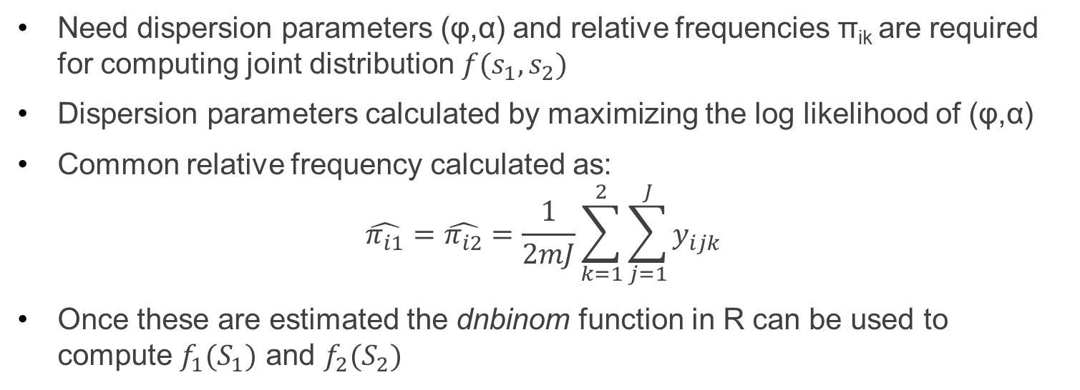
Adaption of the Robison and Smyth and Exact Test
Need dispersion parameters (φ,α) and relative frequencies π_{ik} are required for computing joint distribution $f(s_{1},s_{2})$
Dispersion parameters calculated by maximizing the log likelihood of (φ,α)
Common relative frequency calculated as:
$$\hat{π_{i1}}=\hat{π_{i2}}=\frac{1}{2mJ}\sum_{k=1}^{2}{\sum_{j=1}^{J}{y_{ijk}}}$$
Once these are estimated the dnbinom function in R can be used to compute $f_{1}(S_{1})$ and $f_{2}(S_{2})$

Slide 23
Library Size Adjustments
Previous sections assumed equal active library size….
Benefit of this assumption is that different replicate samples are identically distributed
Sum of iid negative binomial random variables is also a negative binomial random variable – closed form solution possible
In practice active library sizes will not be the same
Authors chose same approach and Robinson and Smyth
Quantile adjustment to observed counts, equalizing active library sizes
Loses efficiency,
Sum of different sized active libraries will induce bias as well as loss of efficiency. Effects less clear

Slide 24
Arabidopsis Example
Arabidopsis thaliana used to model application of NBP distribution
Studied defense of Arabidopsis infection by bacteria – treatment of magnesium chloride assessed
After analysis gene counts were thinned to make active library sizes the same for all samples

Slide 25
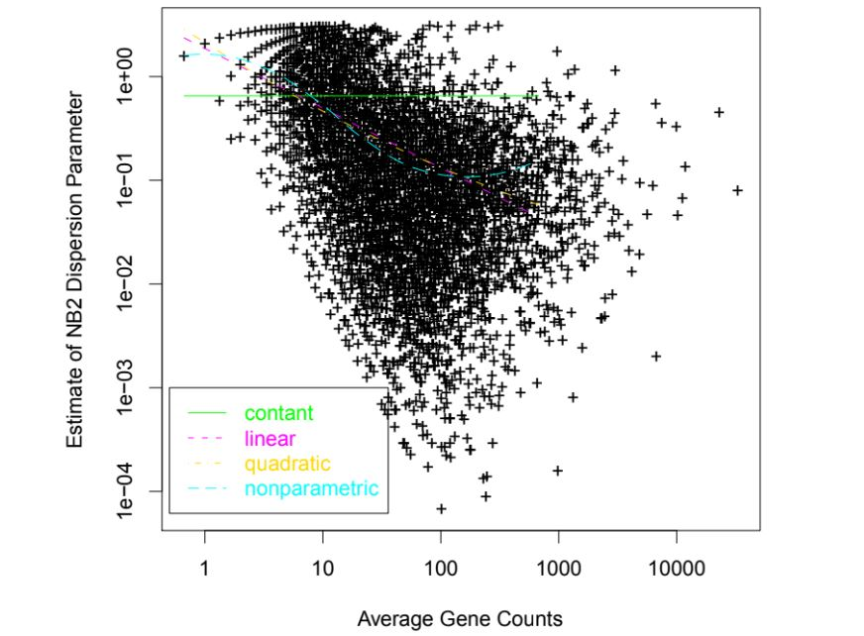
Arabidopsis Example
Figure 1 – compares different probability distributions for sequence read frequencies
Poisson model incorrect – dispersion parameter not 0
NB2 model (green line) incorrect due to changes in dispersion as mean increases
Logged dispersion parameter is a straight line function of the log mean – NBP (magenta)
Yellow line - the logged dispersion parameter is a quadratic function of the log mean
Cyan line - the logged dispersion parameter is a nonparametric function of the log mean

Slide 26
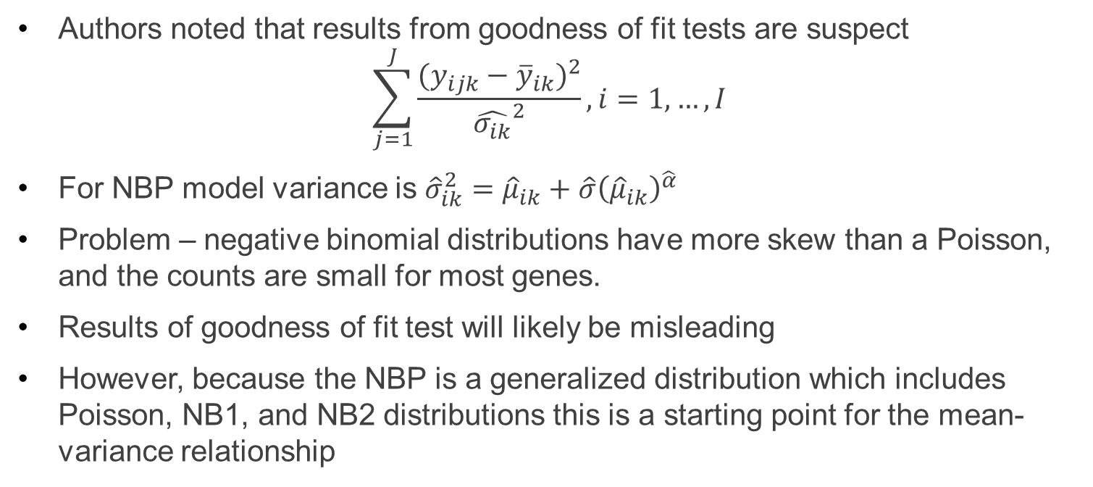
Arabidopsis Example
Authors noted that results from goodness of fit tests are suspect
$$\sum_{j=1}^{J}{\frac{{(y_{ijk}−{\overline{y}}_{ik})}^{2}}{{\hat{σ_{ik}}}^{2}},i=1,…,I}$$
For NBP model variance is ${\hat{σ}}_{ik}^{2}={\hat{μ}}_{ik}+\hat{σ}{\left({\hat{μ}}_{ik}\right)}^{\hat{α}}$
Problem – negative binomial distributions have more skew than a Poisson, and the counts are small for most genes.
Results of goodness of fit test will likely be misleading
However, because the NBP is a generalized distribution which includes Poisson, NB1, and NB2 distributions this is a starting point for the mean-variance relationship

Slide 27
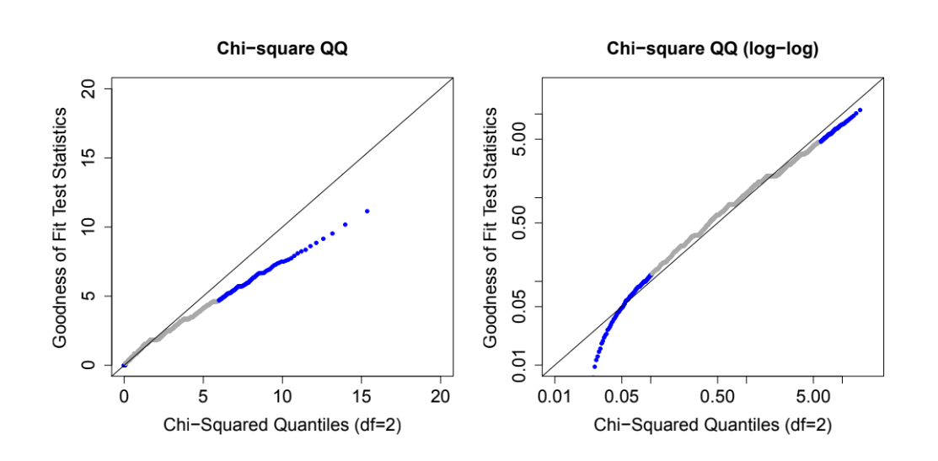
Arabidopsis Example
Notes:
Points high-lighted in blue have chi-square statistic values below the 5-th or above the 95-th percentiles ofa chi-square distribution with 2 degrees of freedom
Plot shows a QQ plot assuming NB2 variation where computer generated data fit the NB2 model exactly
When reads are small QQ plots are not reliable
Log plot is clearer regarding values below the 5-th or above the 95-5h percentiles

Slide 28
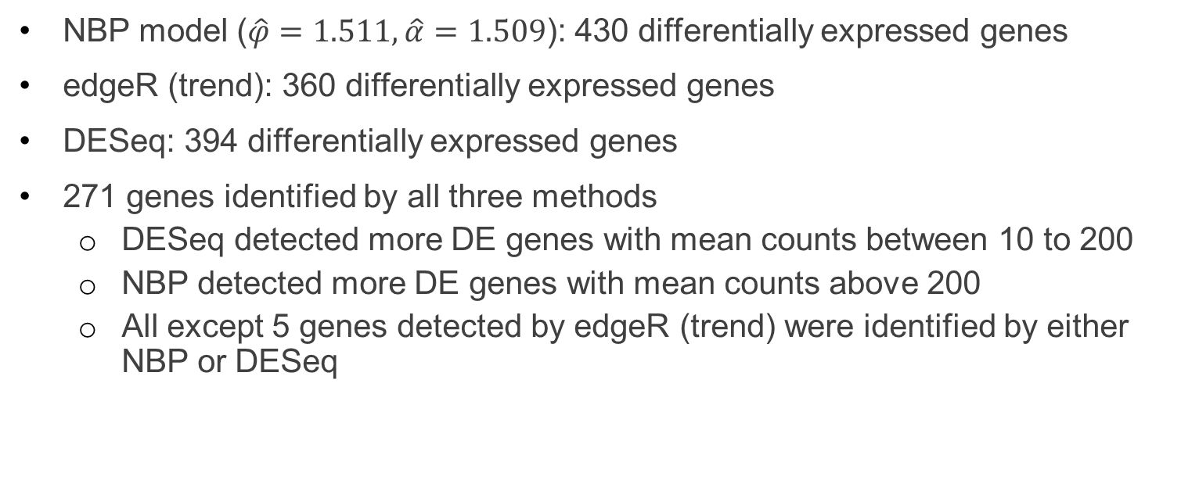
Arabidopsis Example - Results
NBP model ($\hat{φ}=1.511,\hat{α}=1.509$): 430 differentially expressed genes
edgeR (trend): 360 differentially expressed genes
DESeq: 394 differentially expressed genes
271 genes identified by all three methods
DESeq detected more DE genes with mean counts between 10 to 200
NBP detected more DE genes with mean counts above 200
All except 5 genes detected by edgeR (trend) were identified by either NBP or DESeq

Slide 29
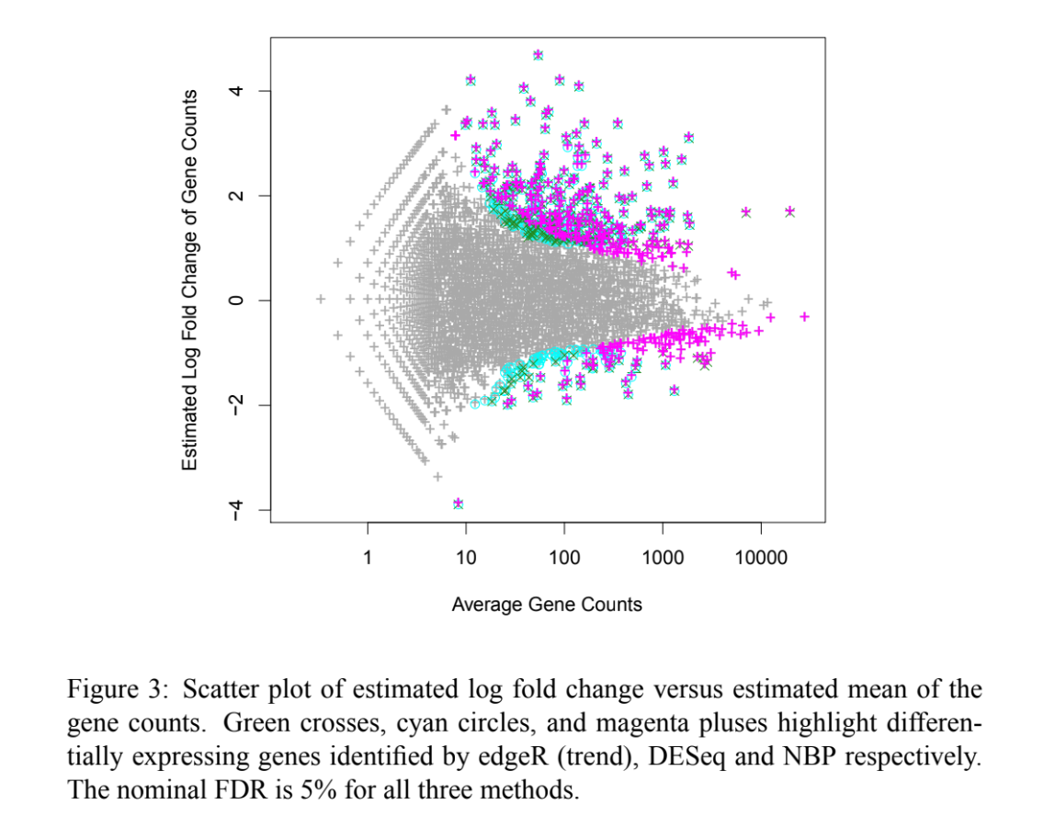
Arabidopsis Example
Notes:
MA plot showing results from different methods

Slide 30
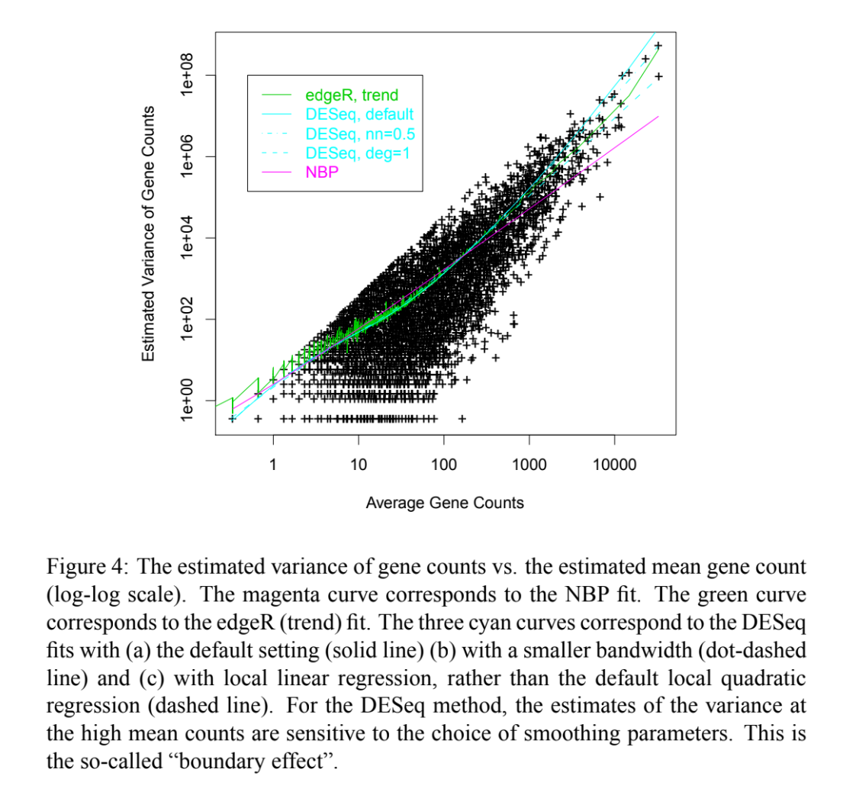
Arabidopsis Example
Notes:
For genes with mean counts above 200 DESeq fit may be too conservative, NBP may be anti-conservative
For genes with mean counts below 200 NBP may be too conservative, DESeq may be anti-conservative
edgeR is intermediate between NBP and DESeq fits

Slide 31
Arabidopsis Example
DESeq method may not be most biologically sensible
Smoothing parameters for DESeq are sensitive to smoothing parameters
Smoothing parameter selection is still a topic of research

Slide 32
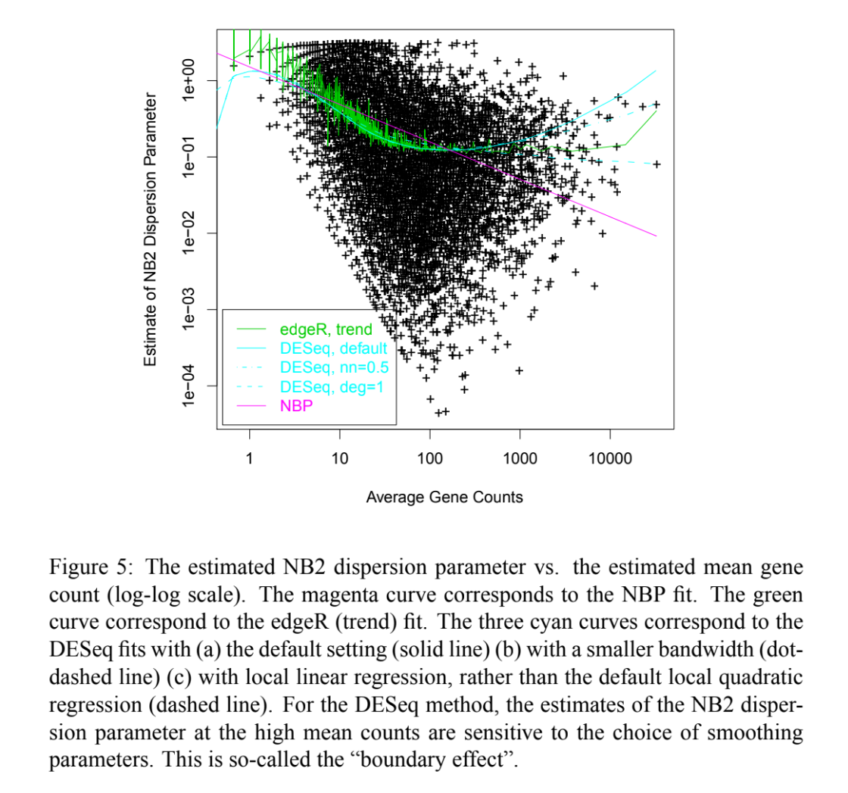
Arabidopsis Example
Notes:
NB2 dispersion parameter is a function of the mean under the NBP model
DESeq dispersion parameter is also a function of the mean with different smoothing parameters
Authors speculated that the true mean-variance curve is somewhere between the local linear fit (dashed cyan curve) and the NBP fit (magenta line)

Slide 33
Simulations
Different methods were compared using simulated data based on the Arabidopsis data
Simulated sequence reads on 26222 genes from 6 biological samples in two treatment groups
430 genes were simulated to be differentially expressing
Variances of RNA-Seq reads were determined according to different NBP models
Poisson: φ = 0, α = 1.0
NB1: φ = 12, α = 1.0
NB2: φ = 0.3, α = 2.0
NBP: φ = 1.5, α = 1.5
NBQ: log(φ) is a quadratic function of log(μ) – deviates from NBP model
1000 data sets simulated under each model. Tests procedures were applied to each (except for the edgeR (trend) which only had 100 simulations applied)

Slide 34
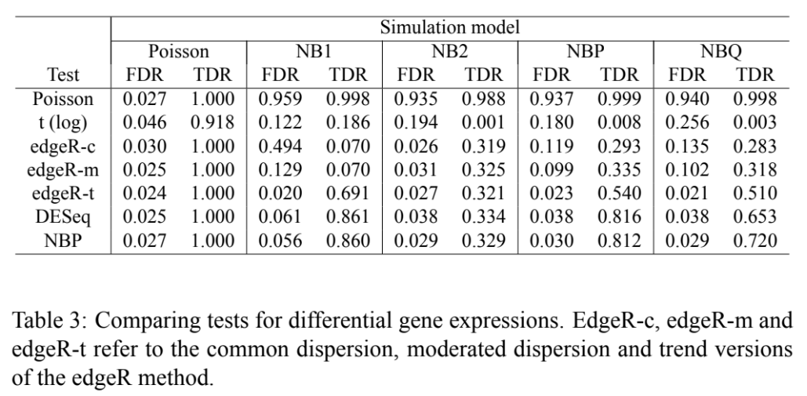
Simulations - Results

Slide 35
Simulation Results
edgeR (trend), DESeq, and NBP kept FDRs below 0.05 when mean-variance follows NBP model
These methods are also robust to slight deviations from NBP (NBQ model)
edgeR (trend) method is more conservative
DESeq and edgeR (trend) did not detect more genes than the simpler NBP model despite their added complexity
edgeR (trend) falls short in part because there were no individual, genewise variations in dispersion parameters simulated
Small sample sizes negate this benefit
DESeq falls short with these simulations because dispersion parameters were simple functions of the mean
Better for more complex situations

Slide 36
Conclusion
For modeling RNA-Seq data approaches that model mean-variance dependence have significantly power than t-tests and non-parametric test
Commonalities between distributions can be used to estimate parameters that can be applied across all genes
Goodness of fit tests are inadequate for judging negative binomial assumptions in practice
However, evidence that negative binomial variance µ(1+φμ) adequately describes the read count variance if log(φ) is a simple function of log(µ)
Higher order asymptotic adjustments to likelihood ratio tests from the NBP model show promising in trivializing the normalization problem

